Slide 1
Cognitive Aspects
Sara Muneeb
sara.muneeb@cuilahore.edu.pk
Computer Science Department

Slide 2
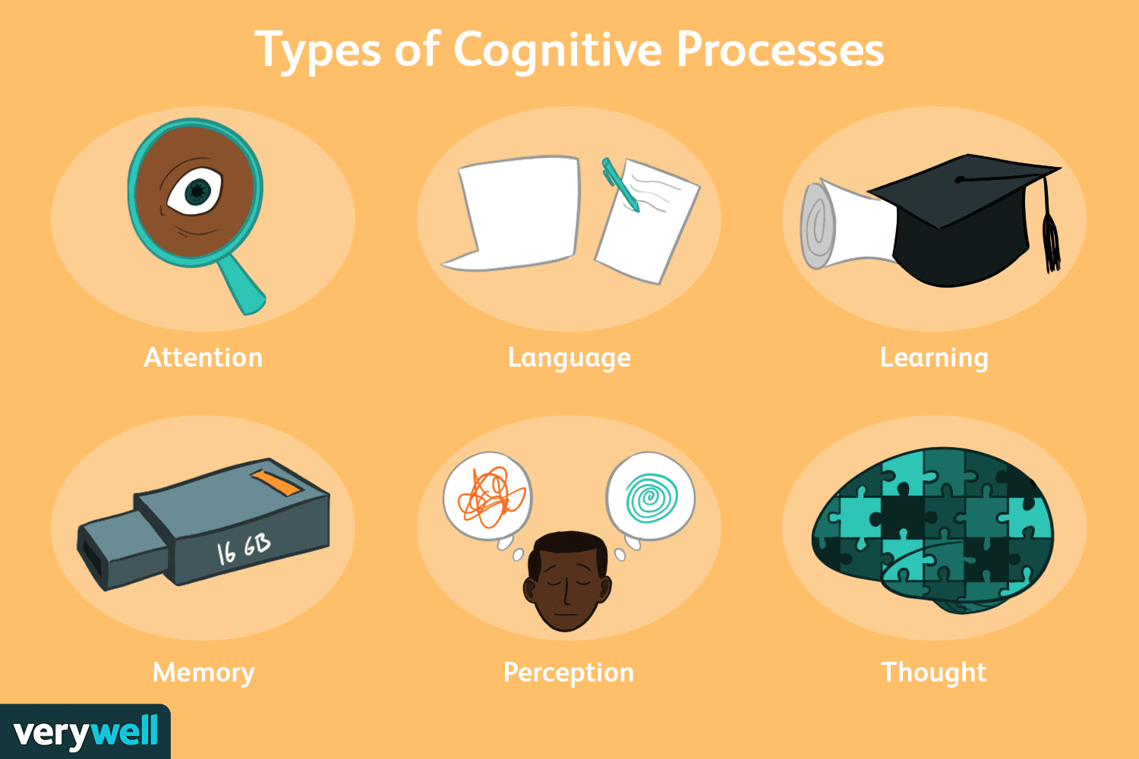
What is Cognition?
The mental action or process of acquiring knowledge and understanding through thought, experience, and the senses.

Slide 3

Experimental Cognition
Experimental Cognition is a state of mind where people perceive, act, and react to events around them intuitively and effortlessly. It requires reaching a certain level of expertise and engagement.
Examples include driving a car, reading a book, having a conversation, and watching a video.

Slide 4

Reflective Cognition
Reflective Cognition involves mental effort, attention, judgment, and decision-making, which can lead to new ideas and creativity.
Examples include designing, learning, and writing a report.
Fast Thinking
5*7 = ?
Slow Thinking
29*35 = ?

Slide 5

Attention
Attention is central to everyday life.
The extent to which this process is easy or difficult depends on
whether someone has clear goals and
whether the information they need is salient in the environment.

Slide 6
Attention
Clear Goals
Information Presentation
Multitasking and Attention

Slide 7
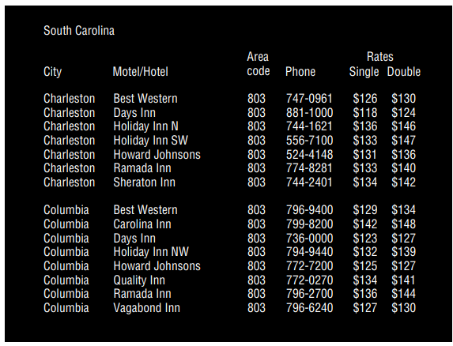

Information presentation

Slide 8
Design Implication: Attention
Consider context
Make information salient when it requires attention at a given stage of a task.
Use techniques to achieve this when designing visual interfaces.
Avoid cluttering visual interfaces with too much information. This applies especially to the use of color and graphics.
Consider designing different ways of supporting effective switching and returning to a particular interface.

Slide 9

Example
login form is not where we expect it to be -> more attention grabbing

Slide 10
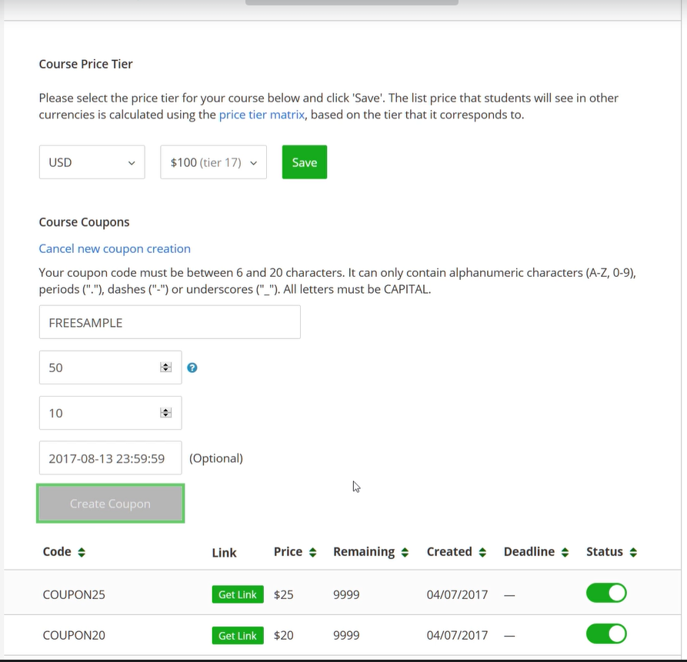
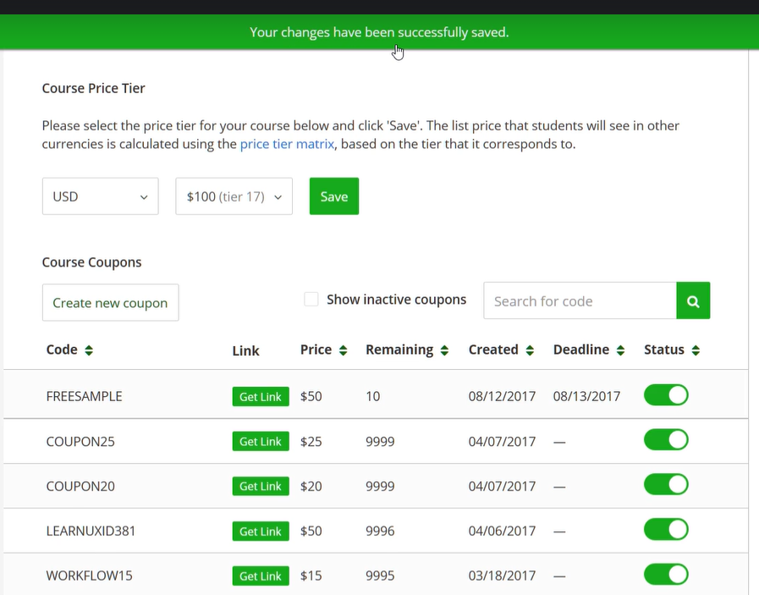
Example
Status msg is not in the periphery of where task was being done.

Slide 11
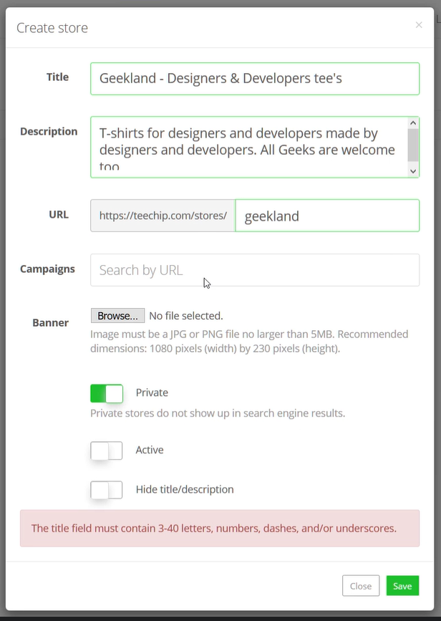
Example
error msg should be at the place where error occurred not at the bottom

Slide 12

Example
msg should ne next to the item being deleted

Slide 13
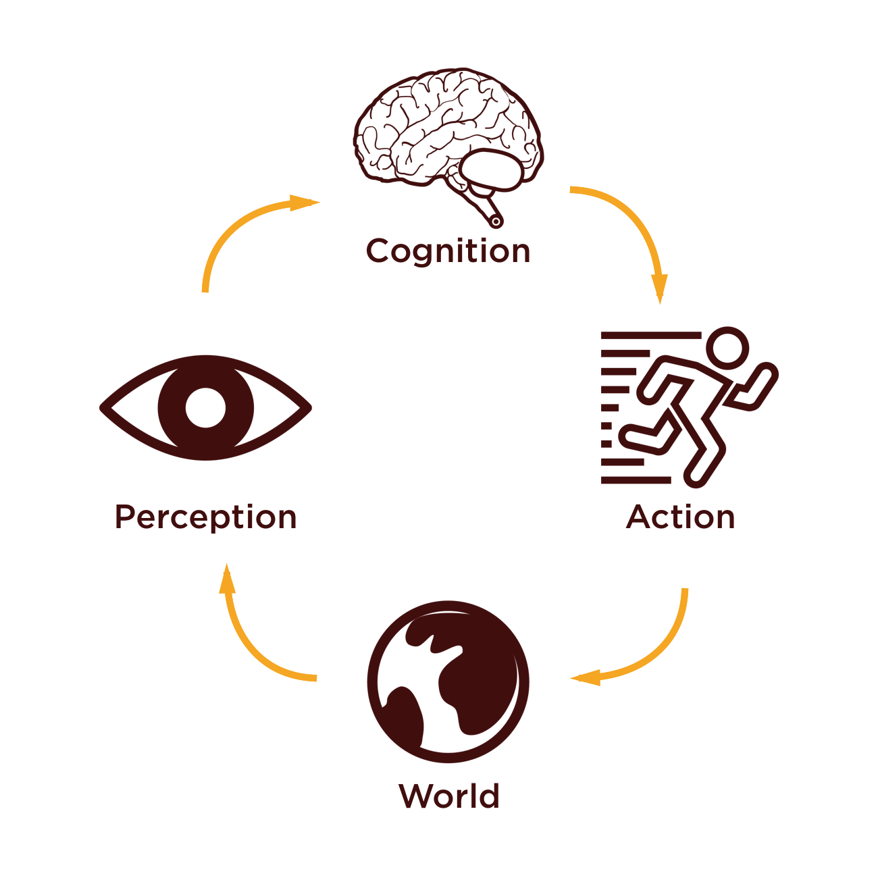
Perception
Perception refers to how information is acquired from the environment via the five senses and are transformed into experiences of objects, events, sounds, and tastes (Roth, 1986).
Additional sense of kinaesthesia,
relates to the awareness of
the position and movement of the
parts of the body through internal
sensory organs.

Slide 14
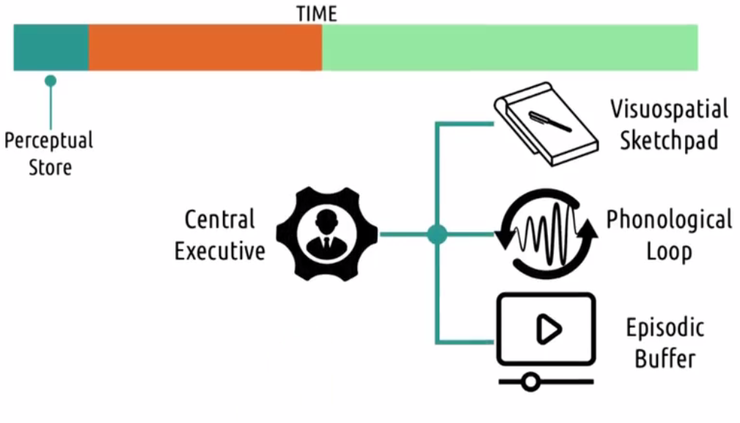
Perceptual Store

Slide 15
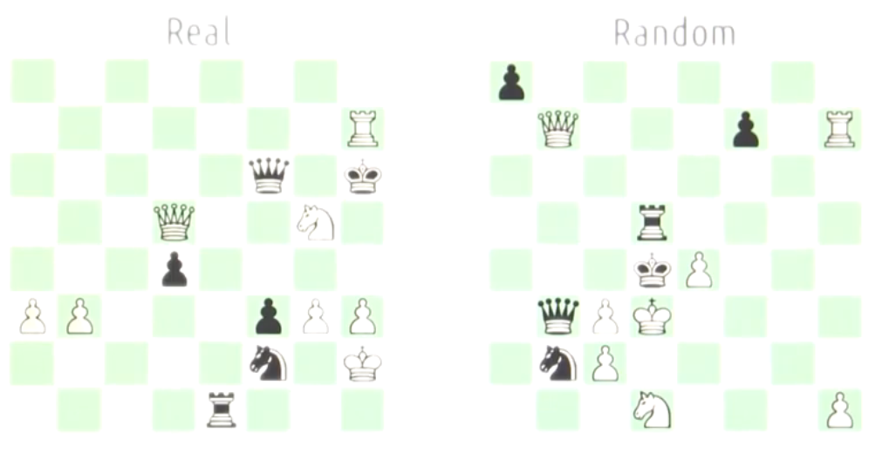
Example
Expertise or rehearsal delays the decay of perceptual buffer.

Slide 16
Design Implication: Perception
Representations of information need to be designed to be perceptible and recognizable across different media.
Design icons and other graphical representations.
Obvious separators and white space
Design clearly distinguishable audio sounds for events
Research proper color contrast
Haptic feedback should be used judiciously.

Slide 17
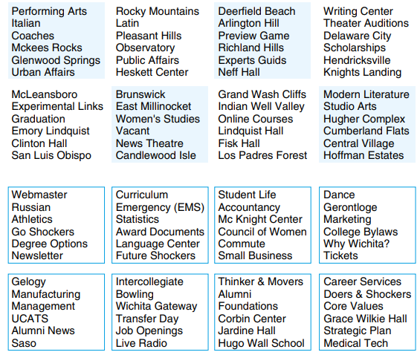
Examples
A study found that people took less time to locate info that was grouped by borders as compared to info that was grouped by color contrast

Slide 18
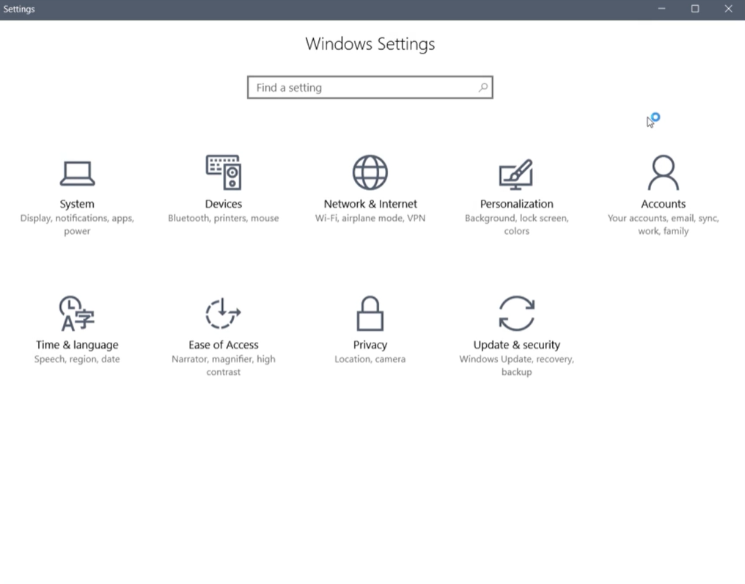
Example

Slide 19
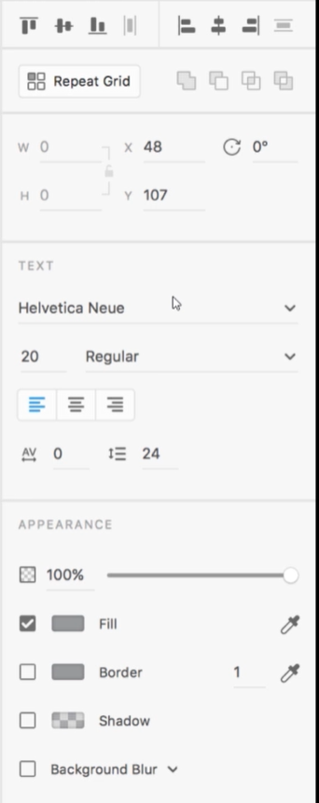
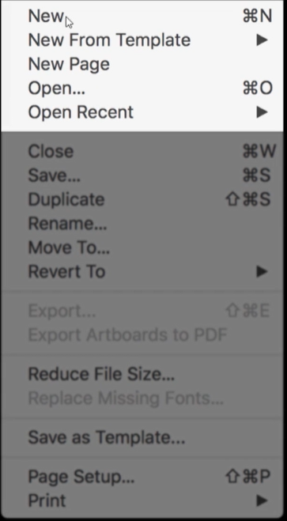
Example

Slide 20
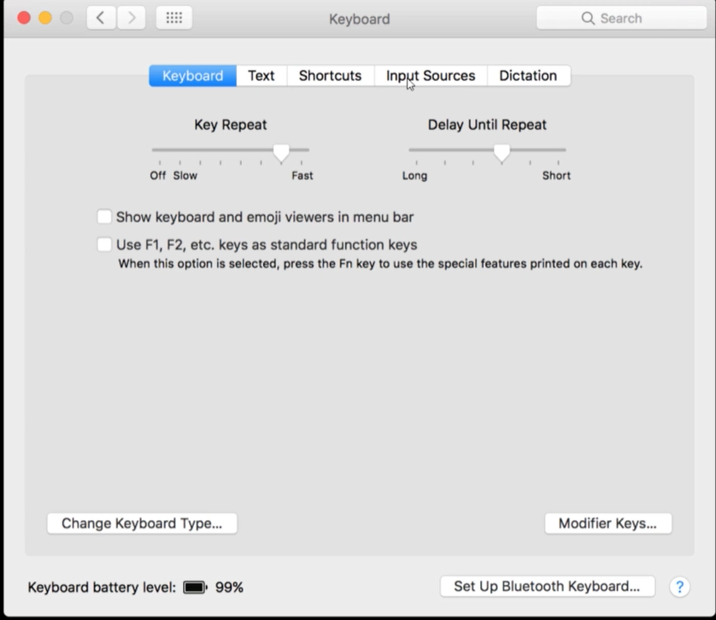
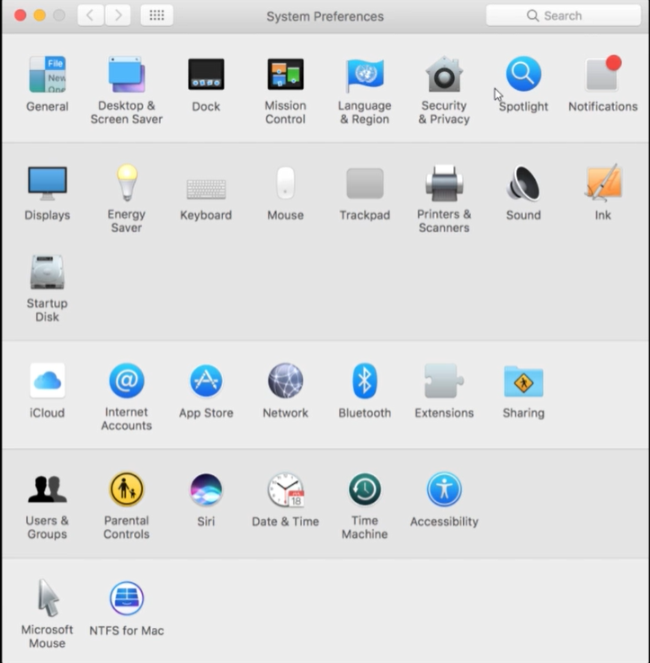
Example

Slide 21


Example
Samsung
Haier

Slide 22
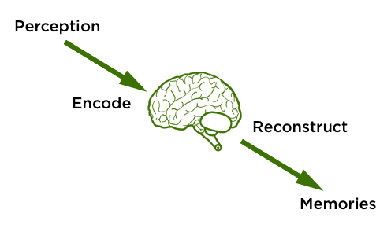
Memory
Memory involves recalling various kinds of knowledge that allow people to act appropriately.
Initially, encoding takes place, determining which information is paid attention to in the environment and how it is interpreted.
Recognition is better than
Recall.

Slide 23
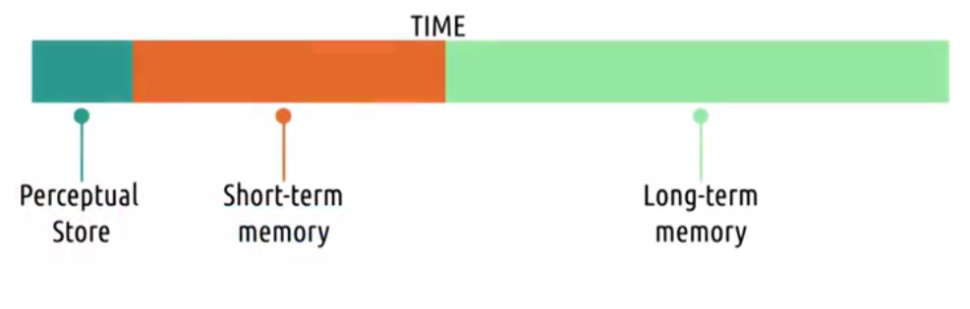
Memory
Short-term memory is the capacity to store a small amount of information in mind and keep it available for a short time.
Long-term memory refers to unlimited storage information to be maintained for long periods, even for life.

Slide 24

Personal Information Management
PIM concerns how people organize and maintain personal information collections, and methods that can help people in doing so.
Steve Whittaker, 2016 Model of PIM
How to decide what personal information to keep?
How to organize that information when sorting it?
Which strategies to use to retrieve it later

Slide 25
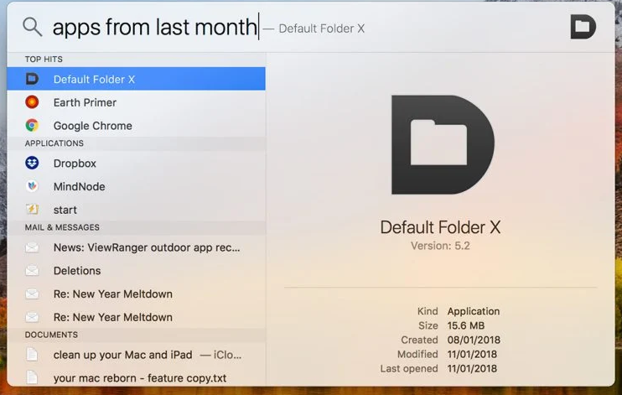
Example

Slide 26
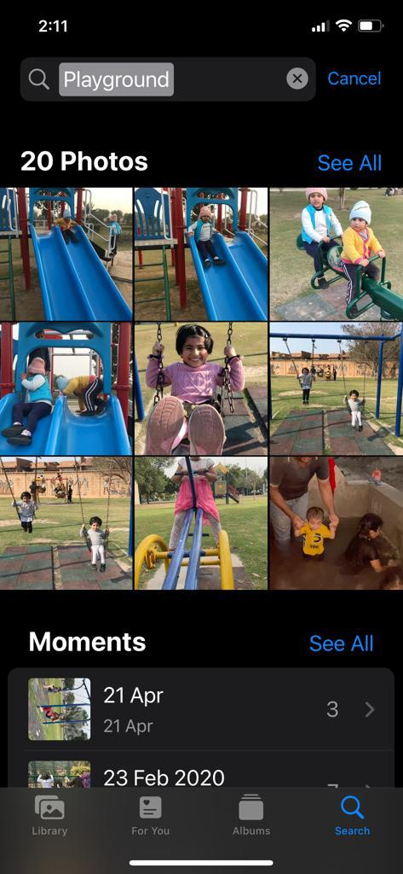
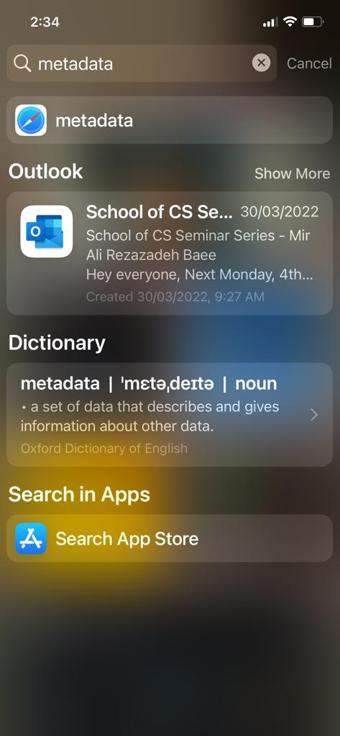
Example

Slide 27
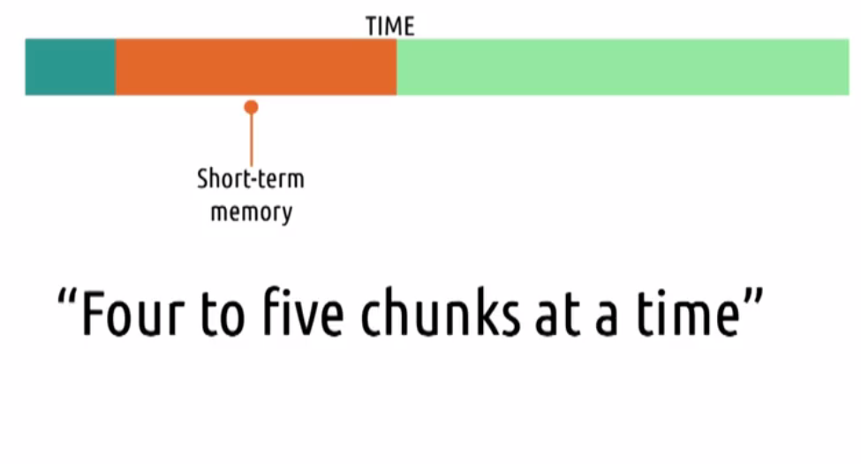
Memory Load and Password
Remembering small chunks of information that do not require frequent recall.

Slide 28
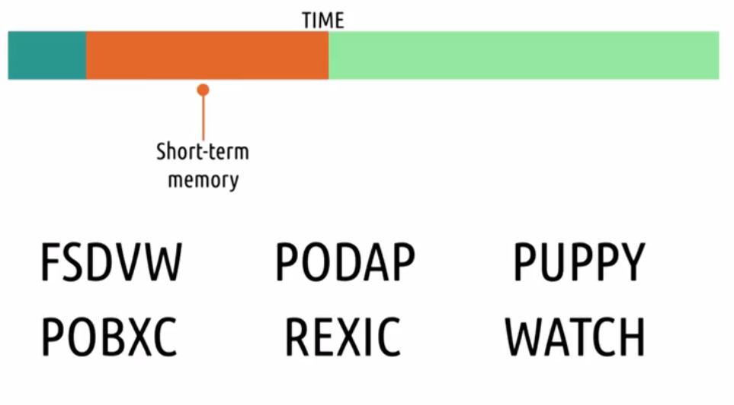
Memory Activity

Slide 29
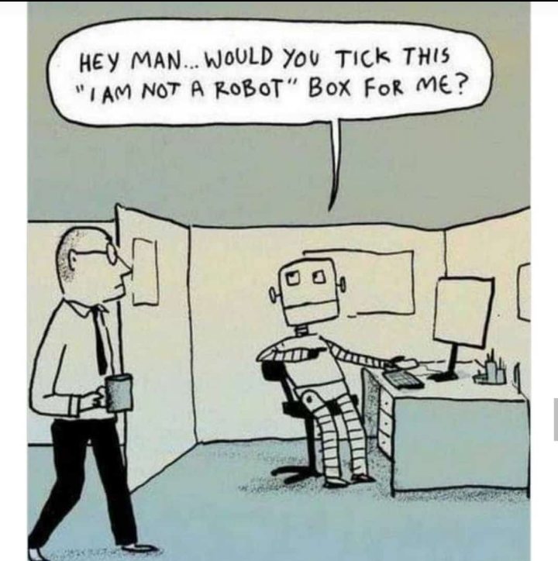
Memory Activity

Slide 30
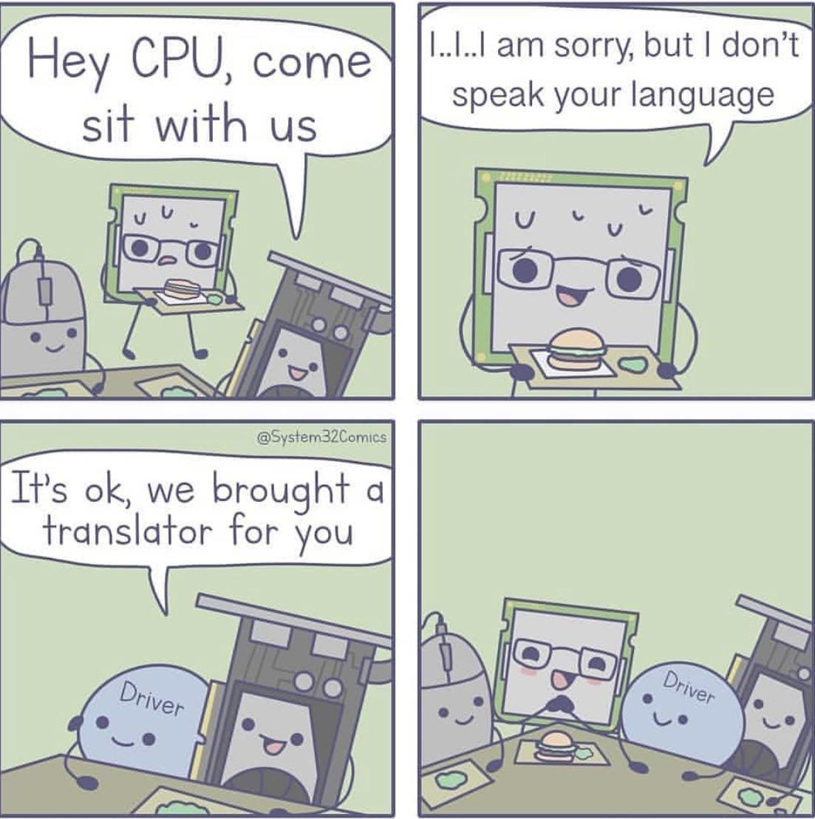
Memory Activity

Slide 31
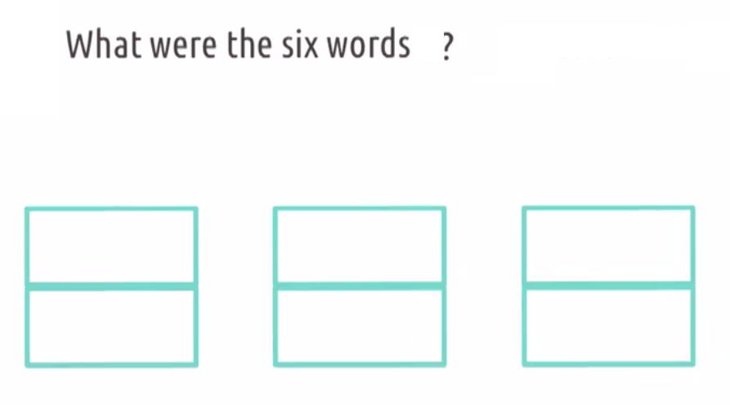
Solution

Slide 32
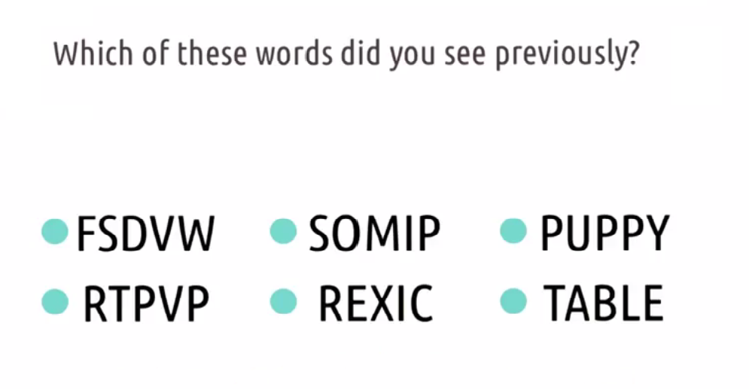
Short-Term Memory and Recognition

Slide 33
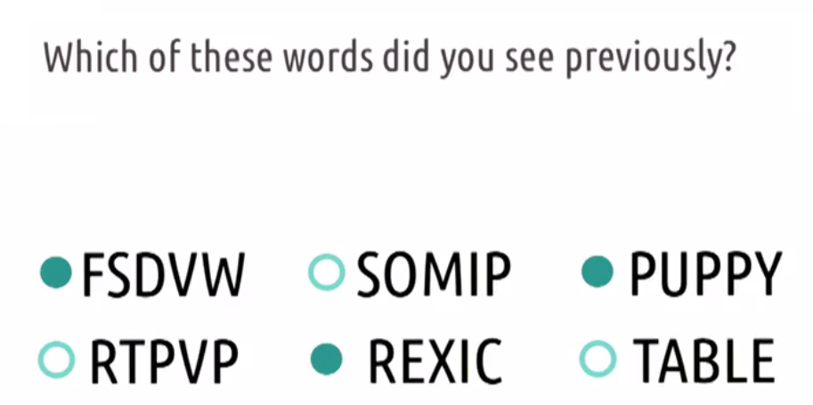
Solution

Slide 34


Short-Term Memory Takeaways

Slide 35
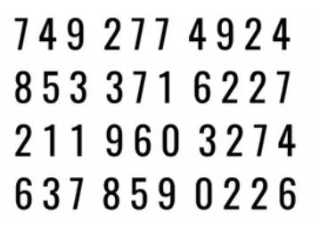
Short-Term Memory Takeaways

Slide 36
Memory: Design Implications
Avoid long and complicated procedures for carrying out tasks
Promote recognition rather than recall by using familiar interaction patterns, menus, icons and objects
Provide variety of ways of labelling information

Slide 37

Learning
It involves the accumulation of skills and knowledge that would be impossible to achieve without memory.
Incidental Learning
occurs without any intention to learn
Intentional Learning
is goal-directed with the goal of being able to remember it

Slide 38
Design Implication : Learning
Design interfaces that encourage exploration.
Design interfaces that constrain and guide users to select appropriate actions when initially learning.

Slide 39
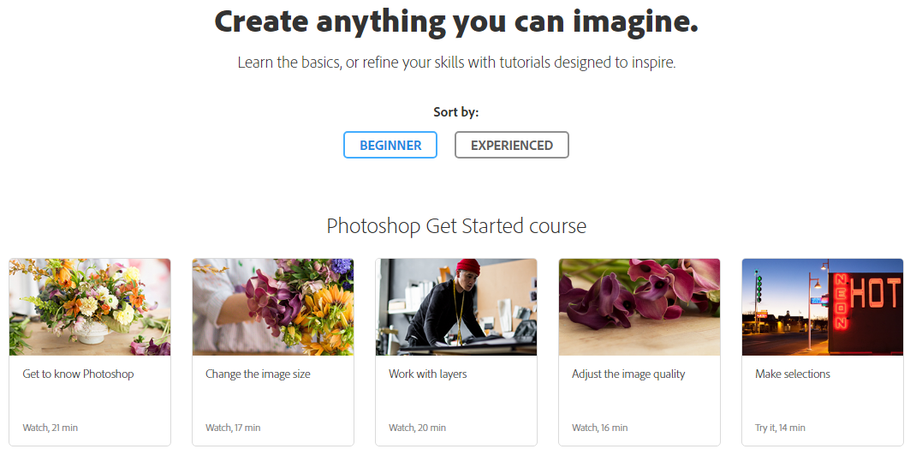
Example

Slide 40

Example

Slide 41
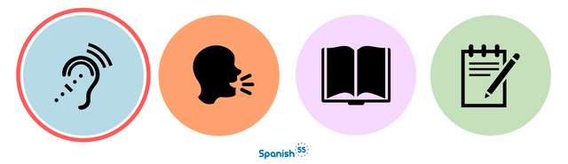
Reading, Speaking and Listening
Reading, speaking, and listening are three forms of language processing that have some similar and some different properties.
Written language is permanent while listening is transient
Written language tends to be grammatical
Reading can be quicker than speaking or listening
Listening requires less cognitive effort than reading or speaking

Slide 42
Design Implications : R,S & L
Keep the length of speech-based menus and instructions to a minimum.
Accentuate the intonation of artificially generated speech voices, as they are harder to understand than human voices.
Provide opportunities for making text large on a screen

Slide 43

Problem Solving, Planning, Reasoning and Decision Making
Problem-solving, planning, reasoning, and decision-making are processes involving reflective cognition.
They include thinking about what to do, what the available options are, and what the consequences might be of carrying out a given action.
This is assumed to involve exhaustively processing the information and making trade-offs between features.
This suggests that an effective design strategy is to make key information about a product highly salient.

Slide 44
Design Implications : PS, P, R & DM
Provide information and help pages
Use simple and memorable functions to support rapid decision-making and planning.
Enable users to set or save their own criteria or preferences.
Avoid decision paralysis

Slide 45
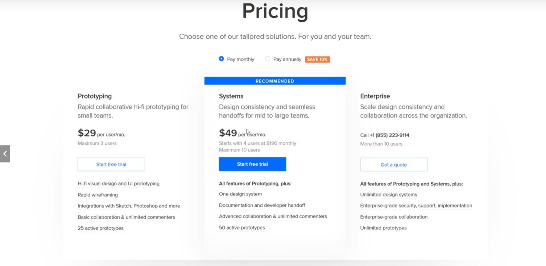
Example

Slide 46

Example

Slide 47
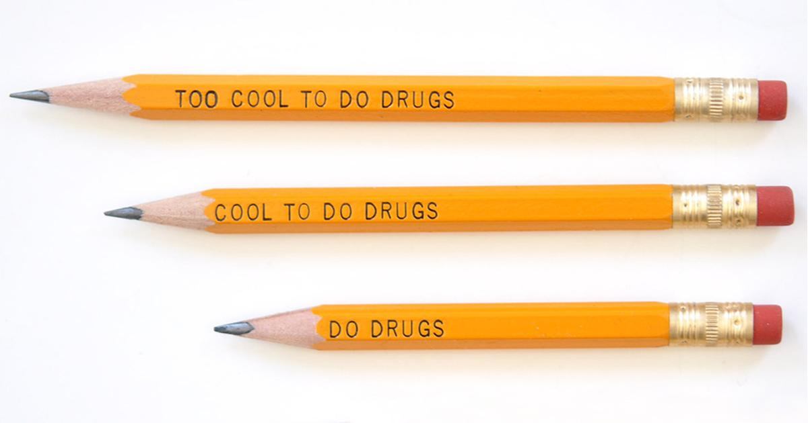
Representation

Slide 48
Cognitive Frameworks
Mental model
Gulf of Evaluation and Execution
Information Processing
Distributed Cognition
External Cognition
Embodied Interactions

Slide 49
Mental Model
Metal Model
An internal, simulatable understanding of external reality
Simulated model helps you to make predictions and understands the real world around you
For example, when you bounce a ball

Slide 50
Mental Model
Make sure that user’s mental model matches the way our system work
Two ways to do this by designing systems
That act the way user expect them to act
That teach the user how they will act.

Slide 51
Metal Model and Education
Teaching analogy
Design interface that teach user while they are using it
Good representation show the user exactly how the system actually works.

Slide 52
Mental Model
Affordance
What the user can see that a object does
Mapping
Relation between control and their effects
Constraints
The state of being checked, restricted or compelled to avoid or perform some action.
Causality
The thing that happen right after an action is assumed by people to be caused by that action.

Slide 53
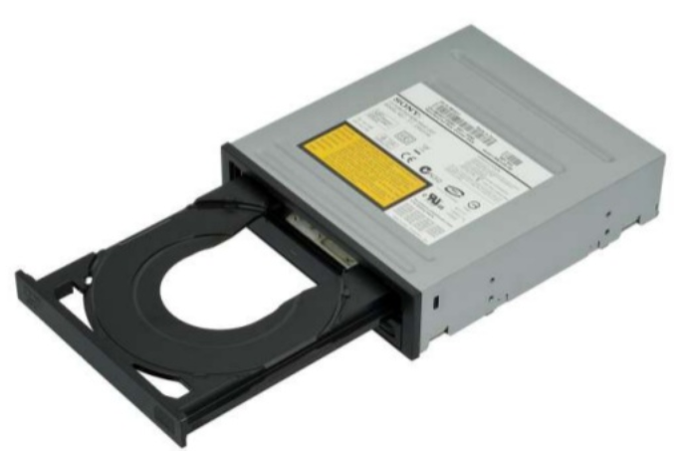

Affordance
Perceived affordance
Types od action user perceives to be possible
Real affordance
Actual actionable properties of object

Slide 54
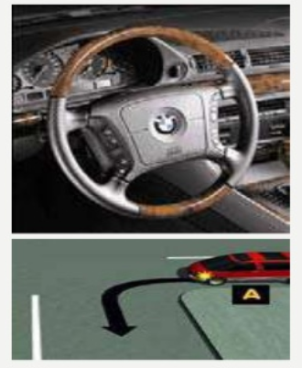
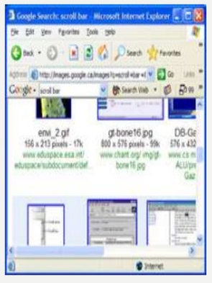
Mapping

Slide 55

Constraints

Slide 56
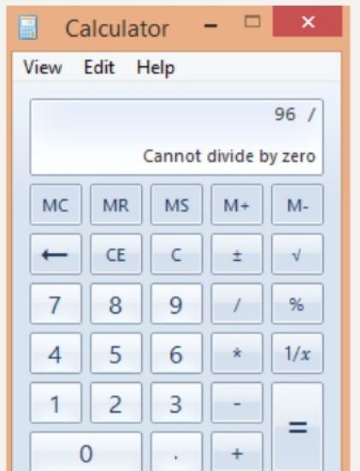
Constraints

Slide 57
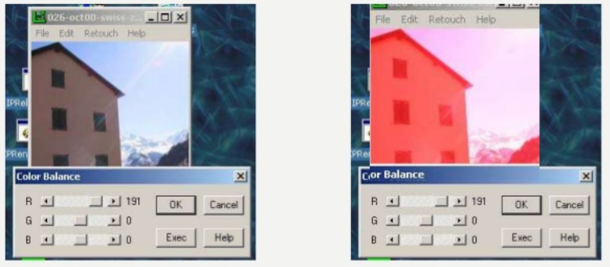
Causality

Slide 58
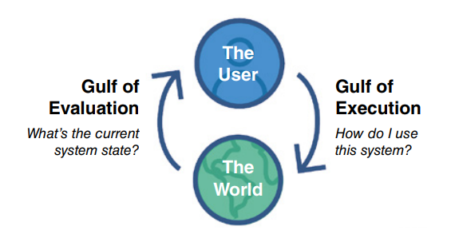
Gulf of Execution and Evaluation
The gulf of execution and the gulf of evaluation describe the gaps that exist between the user and the interface (Norman, 1986; Hutchins et al., 1986)
The gulfs are intended to show how to design the interface to enable the user to cope with them.

Slide 59
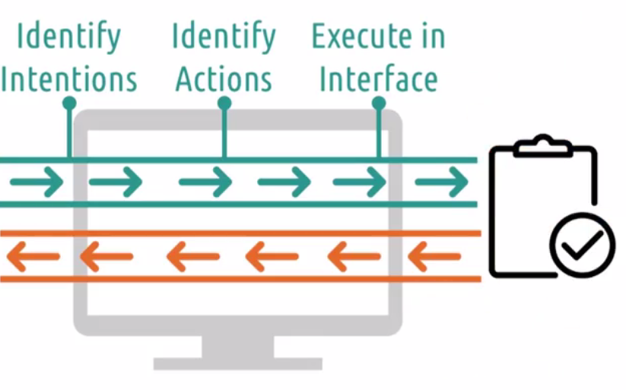

Gulf of Execution

Slide 60
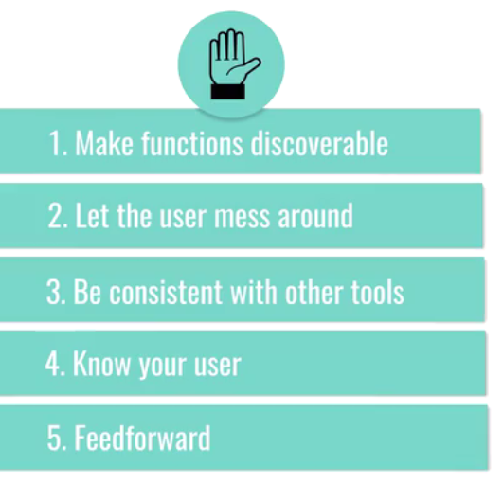
Tip to bridge GoExe

Slide 61
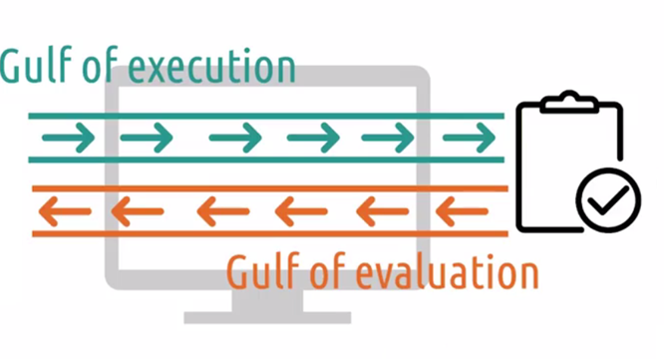
Gulf of Evaluation

Slide 62
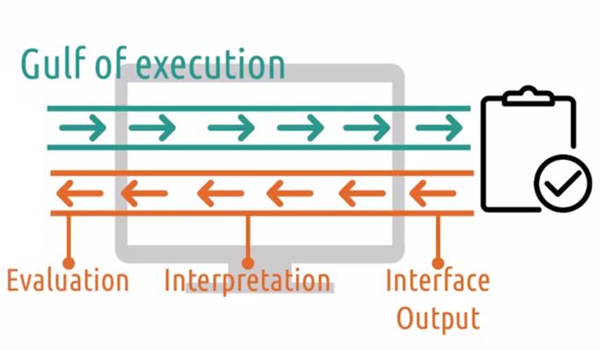
Components

Slide 63
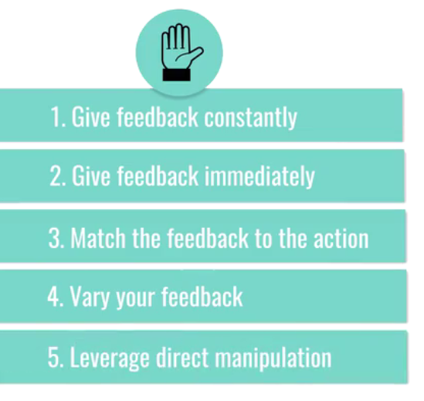
Tips to Bridge GoEva

Slide 64
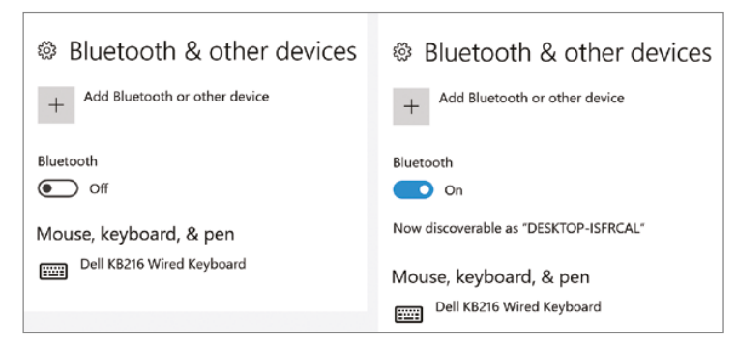

Example

Slide 65
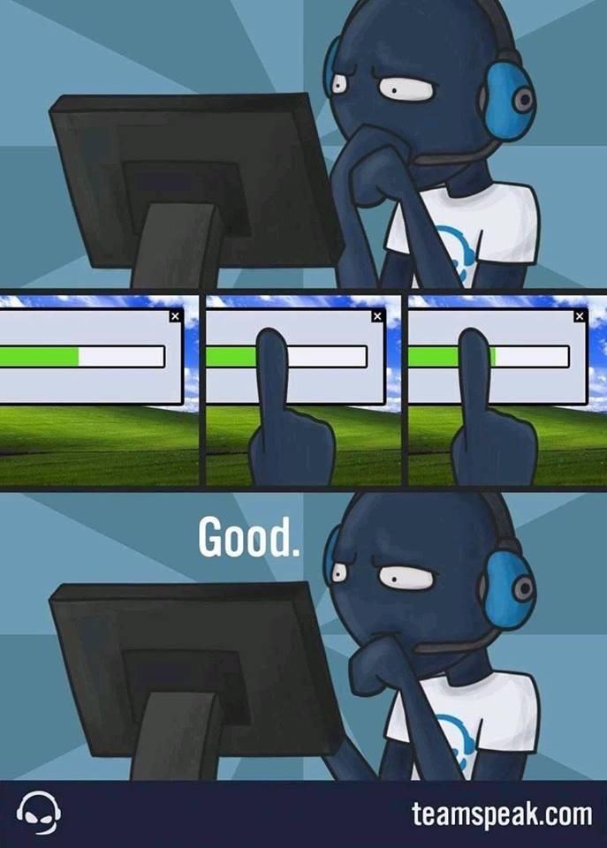
Feed Back is IMP!!!

Slide 66
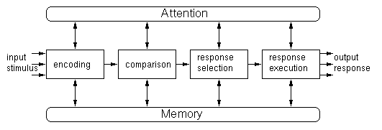
Information Processing
The information processing model provides a basis from which to make predictions about human performance.
Hypotheses can be made about how long someone will take to perceive and respond to a stimulus (also known as reaction time).

Slide 67
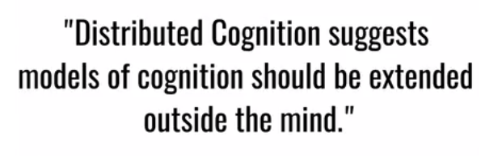
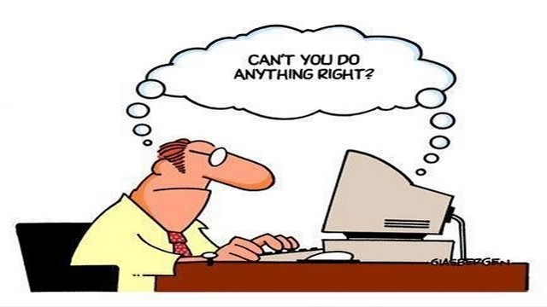
Distributed Cognition
Example : Add two big numbers

Slide 68
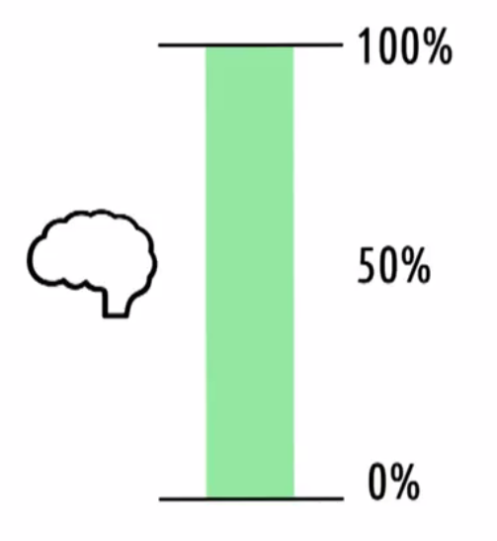
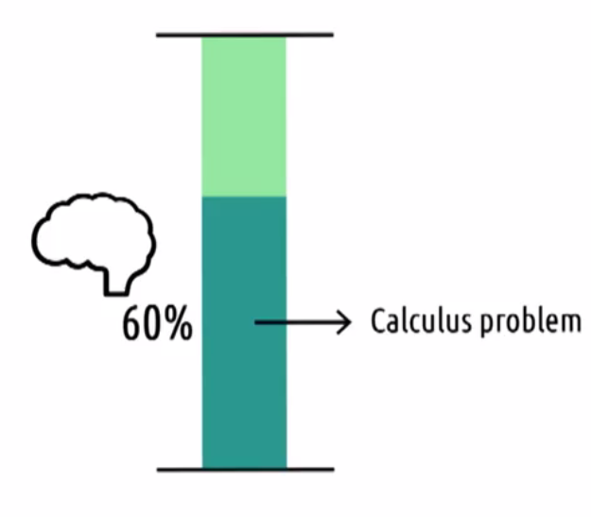
Cognitive Load

Slide 69
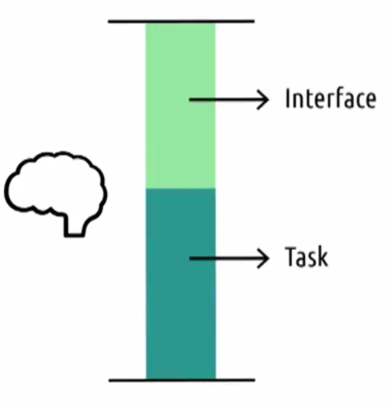

Cognitive Load

Slide 70

Example

Slide 71
External Cognition
External cognition is concerned with explaining the cognitive processes involved when we interact with different external representations such as graphical images, multimedia, and virtual reality.
Externalizing to reduce memory load
Computational offloading
Annotating and cognitive tracing

Slide 72

Embodied Interactions
It involves practical engagement with the social and physical environment by creating, manipulating, and making meaning through our engaged interaction with physical things.

Slide 73
Conclusion
Cognition
Components of Cognition
Frameworks

